Slide 1
Use Our Brains to Think

Slide 2



Today’s plans
Game Video Draw and write

Slide 3
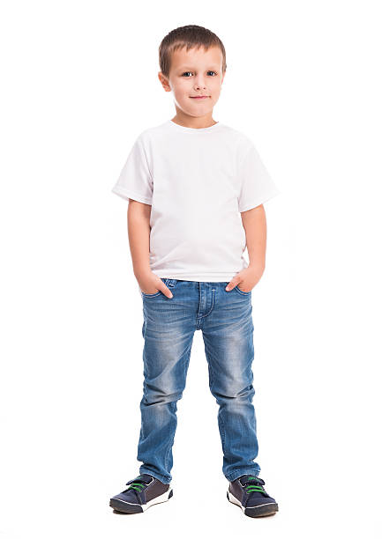
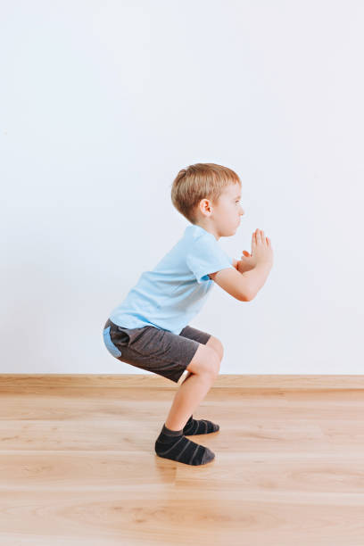
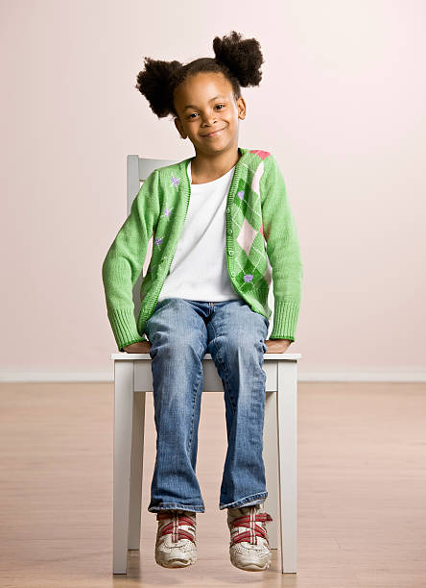
Game
Ms. Lin sit, Ms. Lin sit. Ms. Lin sat, and Jessica sit.

Slide 4
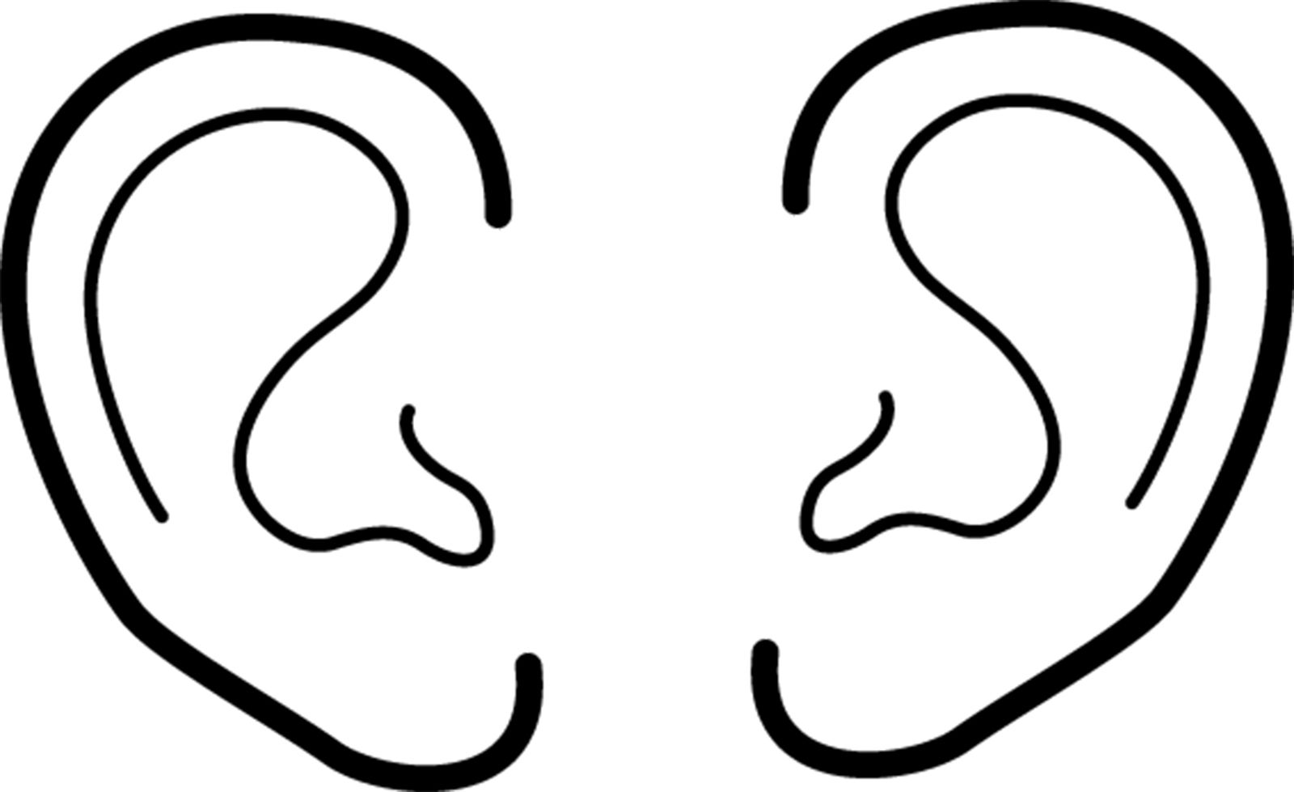

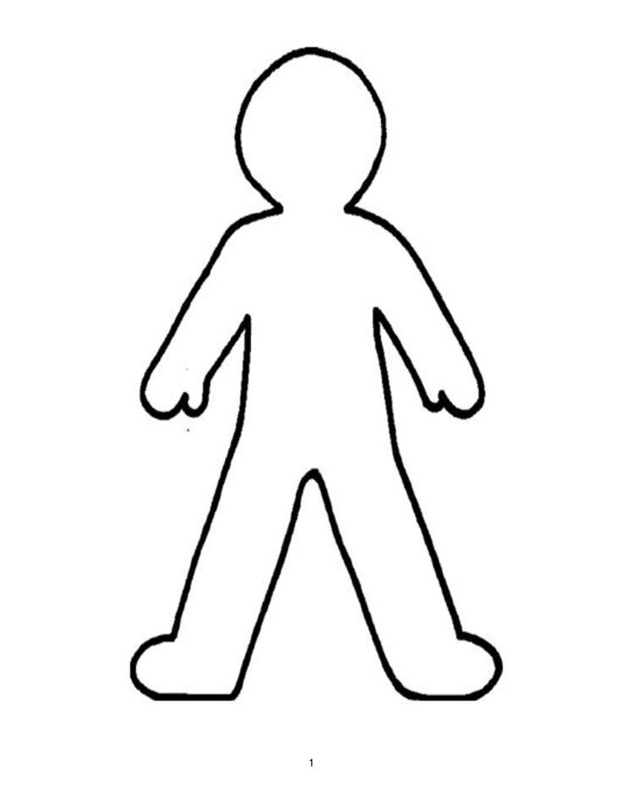
What did you use to play the game?

Slide 5
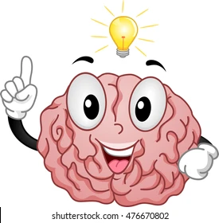
We also used our brains to think!
What did you think of?
What does it mean to think?
Where is our brain?

Slide 6
Watch a video about our brains
https://youtu.be/b79xio8qgiY (x0.75)

Slide 7
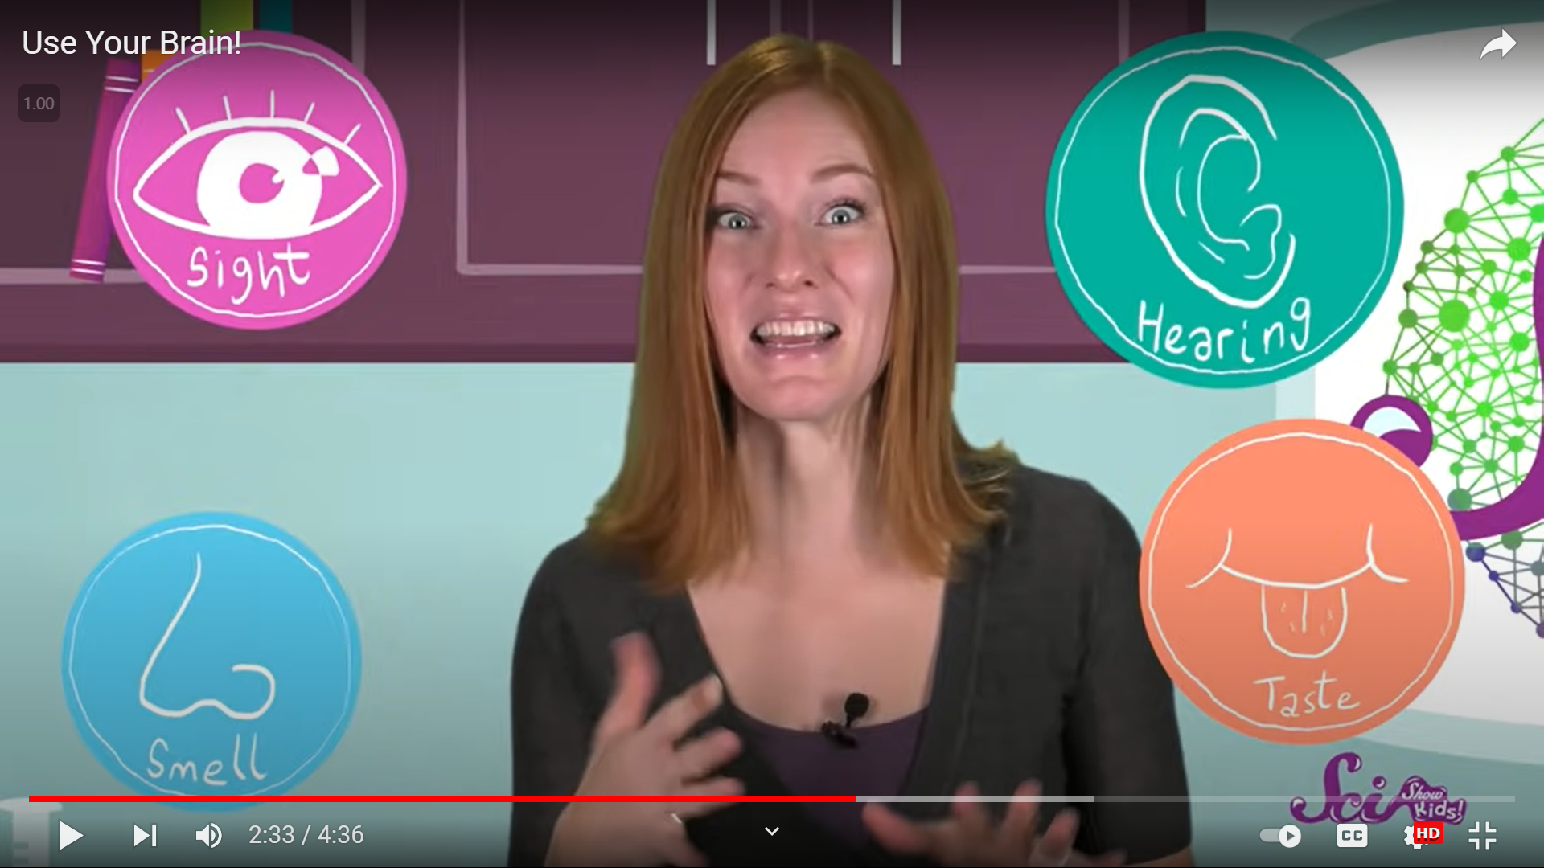
Our brains receive messages

Slide 8
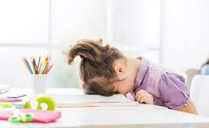
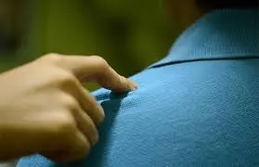
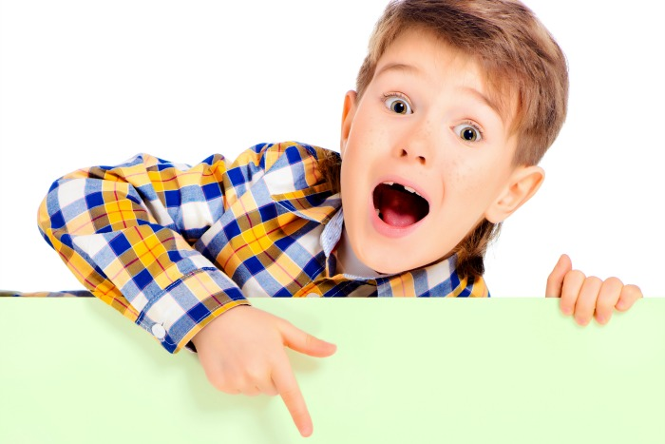
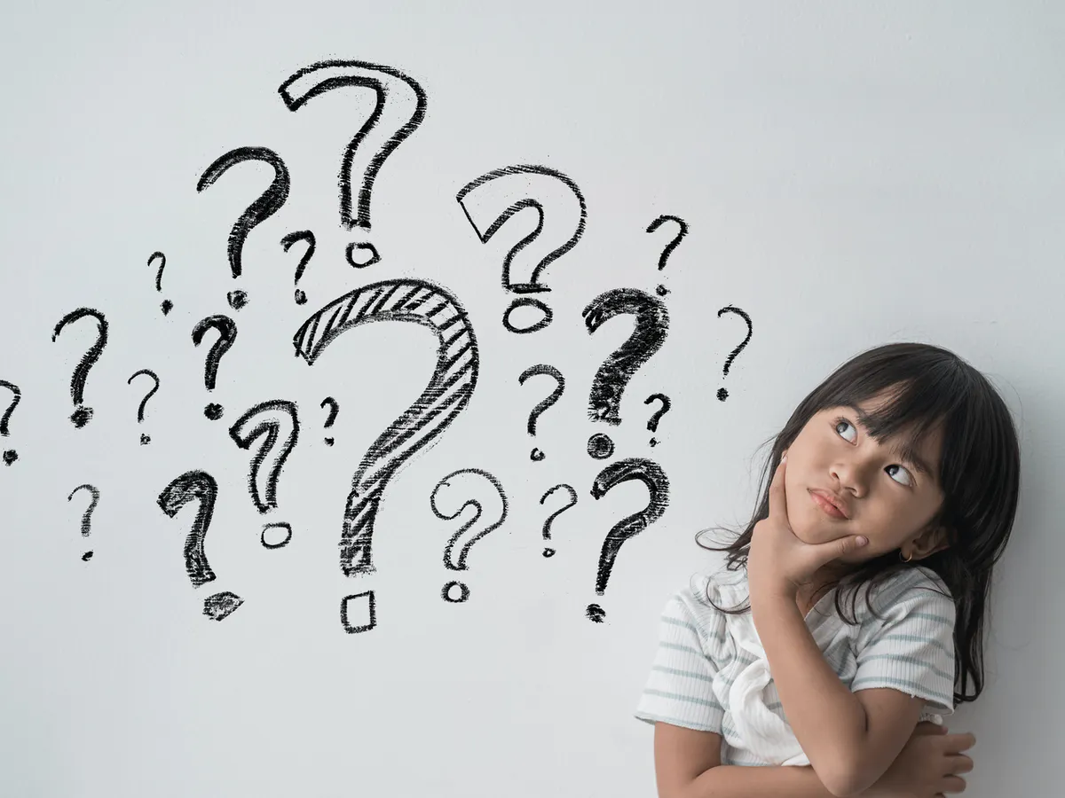
Let’s try it!
Don’t look Tap Say Guess
I like ________. Who said that?
I like my class. Why?

Slide 9
Think
What did the student say?
Who do you think said that?
Why do you think so?

Slide 10
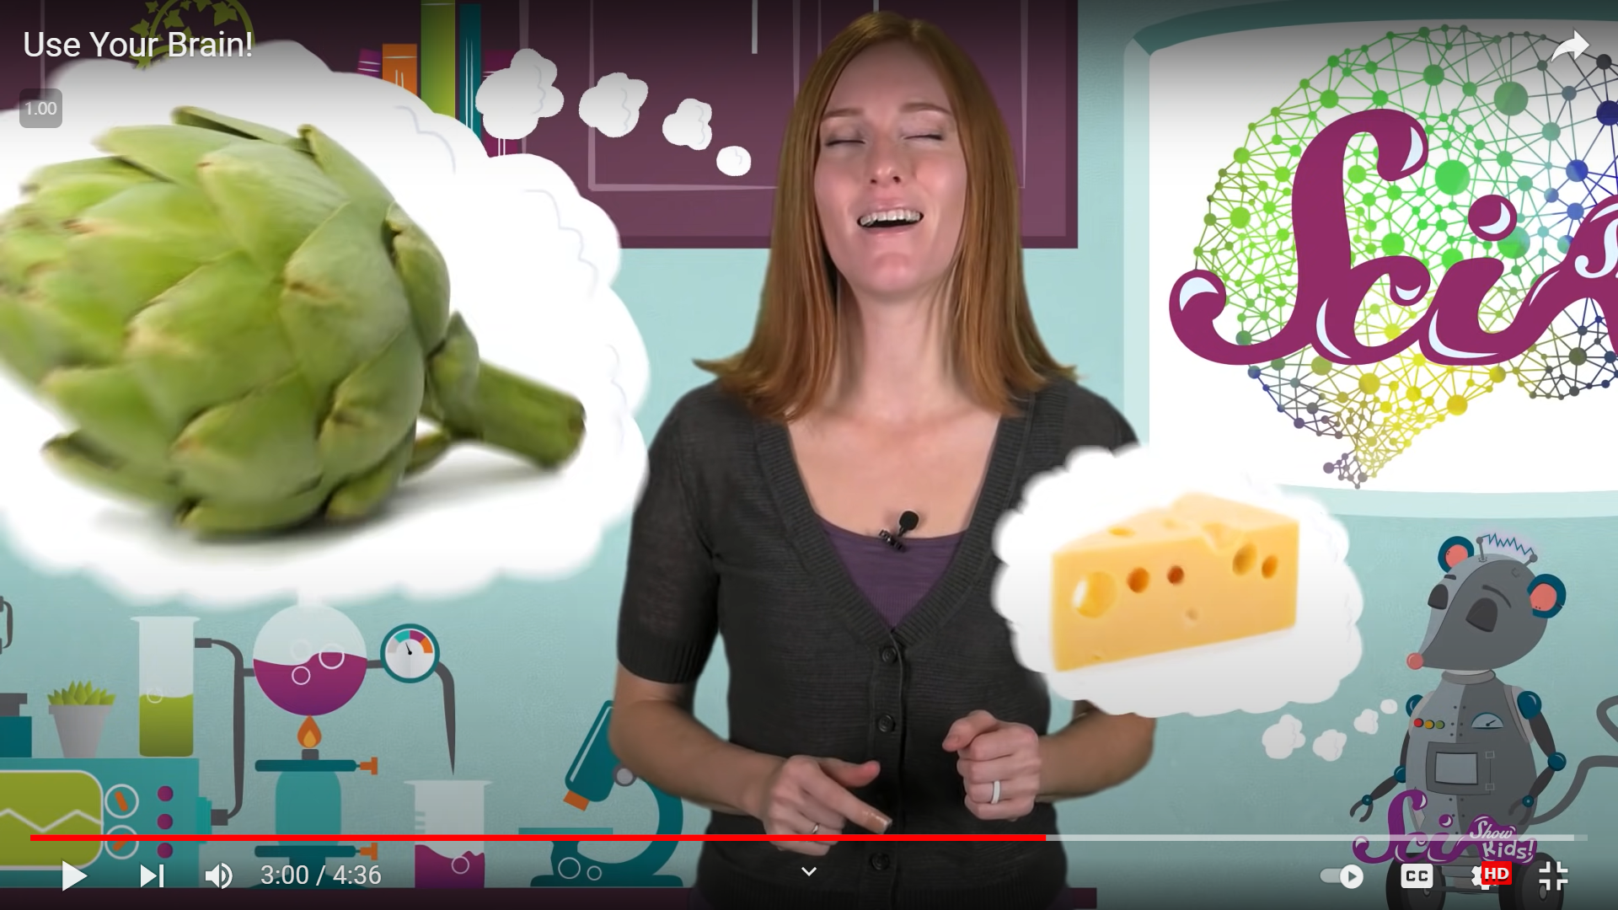
Our brains help us remember things

Slide 11
What is your favourite food?

Slide 12
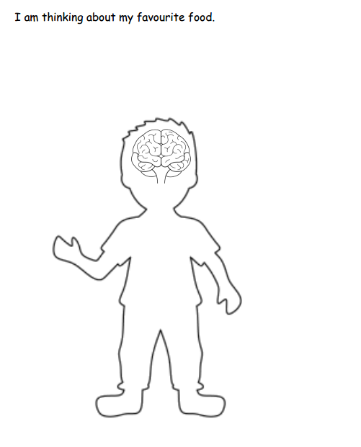
Draw and write!
Color the brain.
Draw a thinking cloud.
Write or draw your favourite food.

